Slide 1
Multiple linear regression CASE STUDY 1
Submitted by: ARUNABHA MONDAL
Uid:18BCS6074

Slide 2
Question:
DESCRIPTION: Predict cancer mortality rates for US counties.
YOUR TASK: Build a multivariate Ordinary Least Squares regression model to predict "TARGET_deathRate"

Slide 3
Process followed
Reading .csv file
Data pre-processing
Data visualisation
Dividing into testing and training set
Building a regression model
Predicting the values of TARGET-DEATHRATE variable
Comparing the value
Finding the r2 value for the model
Creating a OLS to find the other data

Slide 4
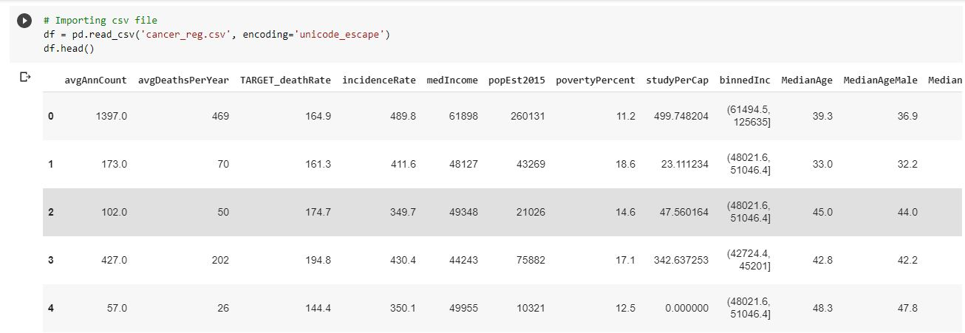
Reading .csv file

Slide 5
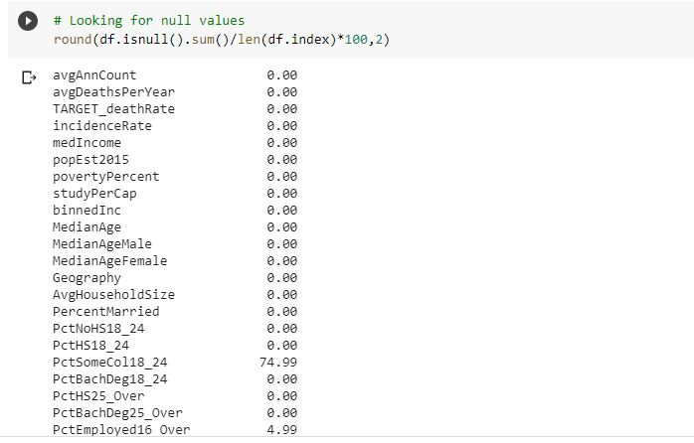
Data pre-processing

Slide 6
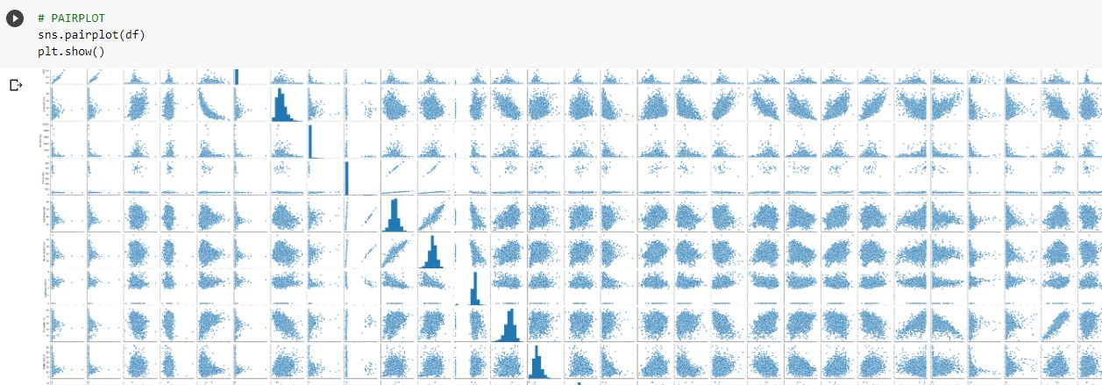
PAIRPLOT of different columns

Slide 7
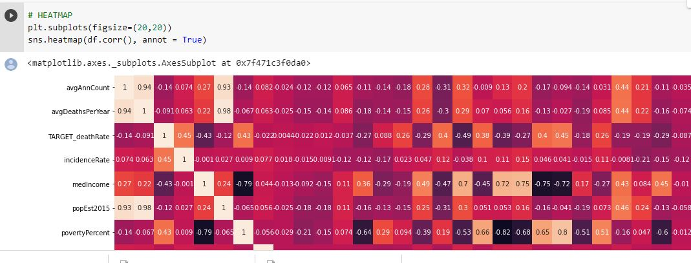
HEATMAP for co-linearity

Slide 8
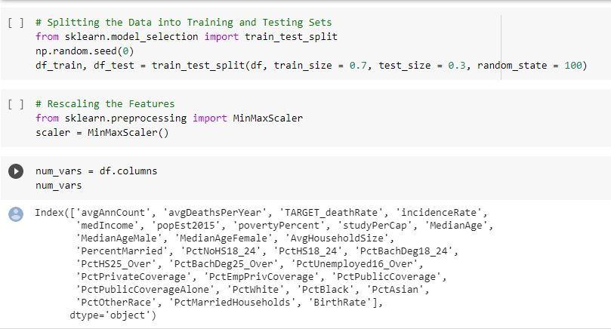
Splitting of data

Slide 9
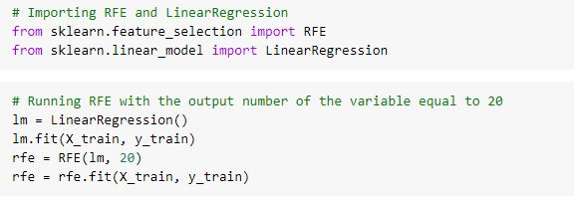
Creating a model

Slide 10
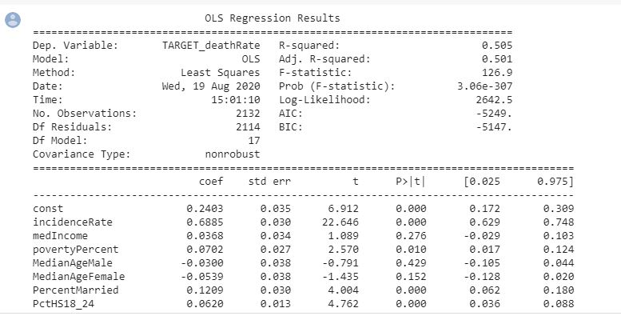
OLS model

Slide 11
Process :
Read .csv from pandas library was used to read the csv file
Imputer from sklearn.datapreprocessing is used to replace the missing values with the mean values.
The data is divided into training and testing parts using test_train_split of sklearn.model_selection library

Slide 12
Cont.…
Model was created using the LINEARREGRESSION from sklearn.linearregression library
The values of Target death rate was predicted using predict method of the linear regression class
R2_score from sklearn.metrics was used to calculate the r2 value of the model
OLS model was used to find the additional values.

Slide 13
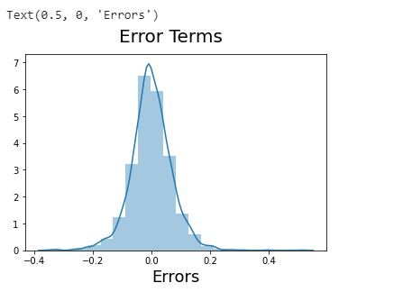
Plotting the Error Terms

Slide 14
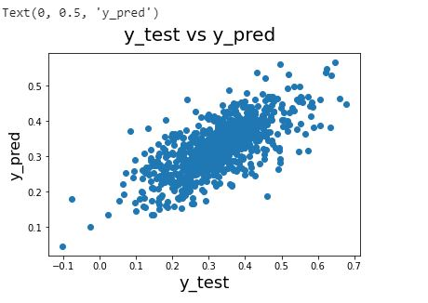
Plot and r2
The scatter plot between
True and predicted values
R^2 value = 0.51

